Slide 1
Vendor Management
How To Make The Most Of Your Relationship

Slide 2
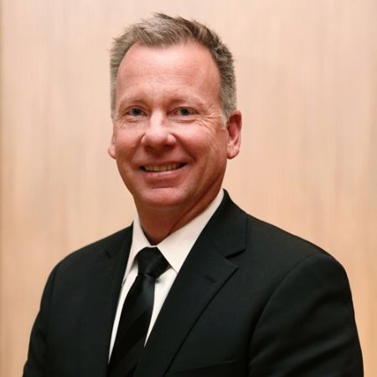
Final Thoughts from George McCloskey
Focus on the Business
Always Find a Way Towards Yes
Business Owns the Risk, Don’t Make It Personal

Slide 3
Final Thoughts from Steven Walter
Clarity is the Key to Understanding
Transparency Breeds Trust
Expectations Must Be Known & Managed Accordingly
Consistently Builds Credibility

Slide 4
Final Thoughts from Scott Jones
Start Early & Do Your Pre-Work
Strive to Eliminate Biases
Develop a Vendor-Partner Mindset
You Don’t Always Get What You Pay For
Read & Know Your Contracts, No Longer than 2 Years
Show Your Work

Slide 5
THANK YOU
Natasha Ryan
Membership Chair/Moderator
Phone : +1 (206) 697-0757
Email : Natasha@premierrisksolutions.com
Website : www.premierrisksolutions.com
Copyright text here

